Slide 1
Part 3.3: Informed (Heuristic) Search
Concept
  A Heuristic is an operationally-effective nugget of information on how to direct search in a problem space. Heuristics are only approximately correct. Their purpose is to minimize search on average.
Informed search methods
Notes:
ICS611-Foundations of A.I
Part3.3 -Informed search

Slide 2
Search with Domain Knowledge added
Uninformed (blind) searches are normally very inefficient
Adding domain knowledge can improve the search process.
Notes:
ICS611-Foundations of A.I
Part3.3 -Informed search

Slide 3
Concept of informed (heuristic) search
Heuristic (informed) search -> explore the node that is most “likely” to be the nearest to a goal state.
There is no guarantee that the heuristic provided most “likely” node will get you closer to a goal state than any other. Sometimes it could be worse

Slide 4

Knowledge/info
Example:1
  City streets
    You are at GPO and would like to the Old Nation Roundabout to get a matatu - What path will you take? Is it the shortest?
      Parallel streets on all sides

Slide 5
Knowledge/info
Example:2
  An office in a city building
    Find me in Office door number N311 (e.g. NSSF, Daystar VR Main Campus ?
      Wing, floor, left/right

Slide 6
Knowledge/info
Example:3
  Visit the doctor
    Symptoms: fever, nausea, headache, …
      Leading questions: how long?, traveled?, … (Malaria, typhoid, meningitis, flu,..)
      x Blood test, y test,...

Slide 7
Knowledge/info
Example:4
  Climbing a hill in thick Fog
    Heuristic function: check the change in altitude in 4 directions; the strongest increase is the direction in which to move next.

Slide 8
Heuristic Searches - Characteristics
Has some domain knowledge
Usually more efficient than blind searches
Also called informed search
Heuristic searches work by deciding which is the next best node to expand (there is no guarantee that it is the best node)

Slide 9
Heuristic Searches - Why Use?
It may be too resource intensive (both time and space) to use a blind search
Even if a blind search will work we may want a more efficient search method

Slide 10
Heuristic Search Methods
Methods that use a heuristic function to provide specific knowledge about the problem:
    Heuristic Functions
    Hill climbing
    Greedy search
    A* search algorithm

Slide 11
Heuristic Functions
To further improve the quality of the previous methods, we need to include problem-specific knowledge on the problem.
  How can this be done in such a way that the algorithms remain generally applicable ???
  HEURISTIC FUNCTIONS:
    f: States --> Numbers
    f(T) : expresses the quality of the state T
      allow to express problem-specific knowledge in the search method algorithm

Slide 12
Example 1: road map
Imagine the problem of finding a route on a road map and that the NET below is the road map:
4
4
A
B
C
3
S
5
5
G
4
F
3
D
2
E
4
Define f(T) = the straight-line distance from T to G
A
10.4
B
6.7
C
4
11
The estimate
can be wrong!
S
8.9
G
D
E
6.9
F
3

Slide 13
Example 2: 8-puzzle
f1(T) = the number correctly placed tiles on the board:
1
3
2
f1
8
4
= 4
5
6
7
f2(T) = number or incorrectly placed tiles on board:
  gives (rough!) estimate of how far we are from goal
1
3
2
f2
8
4
= 4
5
6
7
Most often, ‘distance to goal’ heuristics are more useful !

Slide 14
Example 2: 8-puzzle Manhattan distance
f3(T) = the sum of ( the horizontal + vertical distance that each tile is away from its final destination):
  gives a better estimate of distance from the goal node
1
3
2
f2
8
4
= 1 + 1 + 2 + 2 = 6
5
6
7

Slide 15
Hill climbing
A basic heuristic search method:
  depth-first + heuristic

Slide 16
Hill climbing_1
Example: using the straight-line distance:
S
S
Perform depth-first, BUT:
instead of left-to-right selection,
FIRST select the child with the best heuristic value
10.4
8.9
A
D
10.4
6.9
A
E
6.7
3.0
B
F
G

Slide 17
Hill climbing_2
Inspiring Example: climbing a hill in the fog.
  Heuristic function: check the change in altitude in 4 directions: the strongest increase is the direction in which to move next.
Is identical to Hill climbing_1, except for dropping the backtracking.
Produces a number of classical problems:

Slide 18
Problems with
Hill climbing_2:
Foothills:
Plateaus
Local
maximum
Ridges

Slide 19
Comments:
Foothills are local minima: hill climbing_2 can’t detect the difference.
Plateaus don’t allow you to progress in any direction.
  Foothills and plateaus require random jumps to be combined with the hill climbing algorithm.
Ridges neither: the directions you have fixed in advance all move downwards for this surface.
  Ridges require new rules, more directly targeted to the goal, to be introduced (new directions to move) .

Slide 20
Local search
S
Hill climbing_2 is an example of local search.
In local search, we only keep track of 1 path and use it to compute a new path in the next step.
  QUEUE is always of the form:
    ( p)
A
B
C
D
Another example:
  MINIMAL COST search:
If p is the current path:
  the next path extends p by adding the node with the smallest cost from the endpoint of p
A
3
4
B
C
2
3
5
D
E
F

Slide 21
Heuristic Searches - Greedy search
So named as it takes the biggest “bite” it can out of the problem.
That is, it seeks to minimise the estimated cost to the goal by expanding the node estimated to be closest to the goal state
in other words,
Always expand the heuristically best nodes first.

Slide 22
Greedy search, or
Heuristic best-first search:
S
30
1
10
40
20
At each step, select the node with the best (in this case: lowest) heuristic value.
3
35
15
2
27
18
25
45
The ‘open’
nodes

Slide 23
Greedy search algorithm:
1. QUEUE <-- path only containing the root;
2. WHILE QUEUE is not empty
AND goal is not reached
DO remove the first path from the QUEUE;
create new paths (to all children);
reject the new paths with loops;
add the new paths and sort the entire QUEUE;
3. IF goal reached
THEN success;
ELSE failure;
(HEURISTIC)

Slide 24
Heuristic Searches - Greedy Search
It is only concerned with short term aims
It is possible to get stuck in an infinite loop, unless you check for repeated states
It is not optimal
It is not complete
Time and space complexity is O(B^{m}); where m is the depth of the search tree

Slide 25
Heuristic Searches - A* Algorithm
A combination of Greedy search and Uniform cost search. - to compliment one another
This search method minimises the cost to the goal using an heuristic function, h(n). Greedy search can considerably cut the search time but it is neither optimal nor complete. By comparison uniform cost search minimises the cost of the path so far, g(n). Uniform cost search is both optimal and complete but can be very inefficient.

Slide 26
Road map example:
Re-introduce the costs of paths in the NET
4
4
3
A
B
C
S
5
5
G
4
3
D
2
E
4
F
3
S
4
4
A
D
2
5
5
B
D
A
E
4
5
2
4
5
4
C
2
E
4
5
E
B
B
F
4
4
5
4
4
3
D
F
B
F
C
E
A
C
G
3
4
3
4
G
C
G
F
3
G

Slide 27
A look at Uniform cost search
= uniformed best-first
3
S
4
3
4
4
A
5
D
At each step, select the node with the lowest accumulated cost.
5
2
B
7
8
A
9
6
D
5
E
4
5
5
4
4
C
11
12
13
B
13
B
11
F
10
E
E
3
D
F
B
F
C
E
A
C
G
13
G
C
G
F
G

Slide 28
Now incorporate heuristic estimates
Replace the ‘accumulated cost’ in the ‘Uniform cost search’ by a function:
f(path) = cost(path) + h(endpoint_path)
fn
g(n)
h(n)
where:
cost(path) = the accumulated cost of the partial path
h(T) = a heuristic estimate of the cost remaining
from T to a goal node
f(path) = an estimate of the cost of a path extending
the current path to reach a goal.
fn = g(n) + h(n)

Slide 29
Heuristic Searches - A* Algorithm
Combines the cost so far and the heuristic estimated cost to the goal. That is fn = g(n) + h(n)
This gives us estimated cost of the cheapest solution through path n
It can be proved to be optimal and complete providing that the heuristic is admissible.
That is the heuristic must never over estimate the cost to reach the goal.
But, the number of nodes that have to be searched still grows exponentially

Slide 30
Example: road map
Imagine the problem of finding a route on a road map. The paths distances between nodes define g(n):
4
4
A
B
C
3
S
5
5
G
4
F
3
D
2
E
4
Define h(n) = the straight-line distance from node to G
A
10.4
B
6.7
C
4
11
S
8.9
G
D
E
6.9
F
3

Slide 31
S
3 + 10.4 = 13.4
A
D
4 + 8.9 = 12.9
S
A
13.4
D
9 + 10.4 = 19.4
A
E
6 + 6.9 = 12.9
X
S
A
13.4
D
A
E
X
11 + 6.7 = 17.7
B
F
10 + 3.0 = 13.0
S
A
13.4
D
A
E
STOP!
X
17.7
B
F
G
13 + 0.0 = 13.0

Slide 32
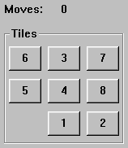

Heuristic Searches - A* Algorithm for 8-Puzzle Example
Initial State
Goal State
Typical solution is about twenty steps
Branching factor is approximately three. Therefore a complete search would need to search 3²⁰ states. But by keeping track of repeated states we would only need to search 9! (362,880) states
But even this is a lot (imagine having all these in memory)
Our aim is to develop a heuristic that does not over estimate (it is admissible) so that we can use A* to find the optimal solution

Slide 33
Heuristic Searches - Possible Heuristics
H₁ = the number of tiles that are in the wrong position (=7)
H₂ = the sum of the distances of the tiles from their goal positions using the Manhattan Distance (=18)
Both are admissible but which one is best?

Slide 34
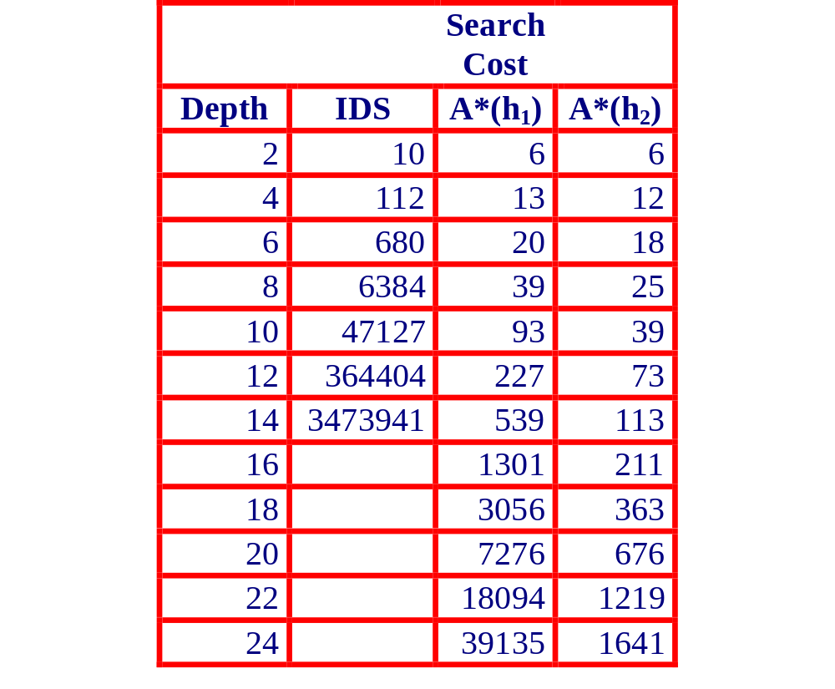
Test from 100 runs with varying solution depths
H₂ looks better as fewer nodes are expanded. But why?

Slide 35
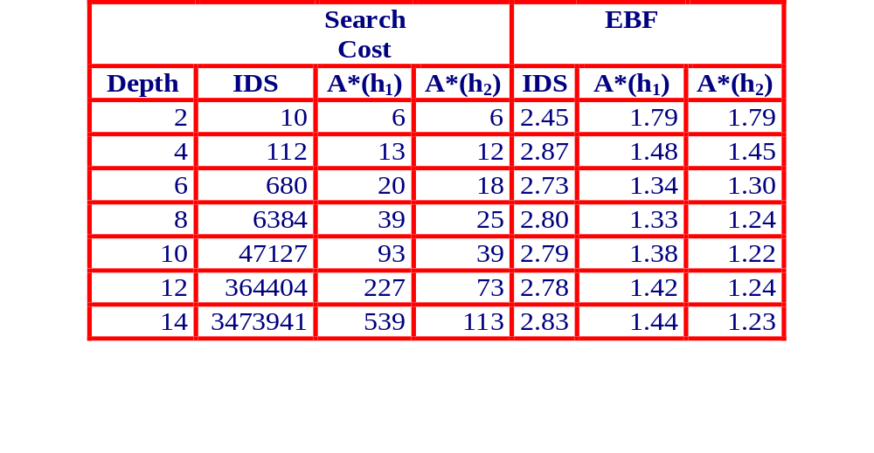
Effective Branching Factor
H₂ has a lower branching factor and so fewer nodes are expanded
Therefore, one way to measure the quality of a heuristic is to find its average branching factor
H₂ has a lower EBF and is therefore the better heuristic

Slide 36
Summary
Blind Search is very expensive
A Search with info (heuristics) is far better
Info can be difficult to incorporate
The more info, the better

